Slide 1
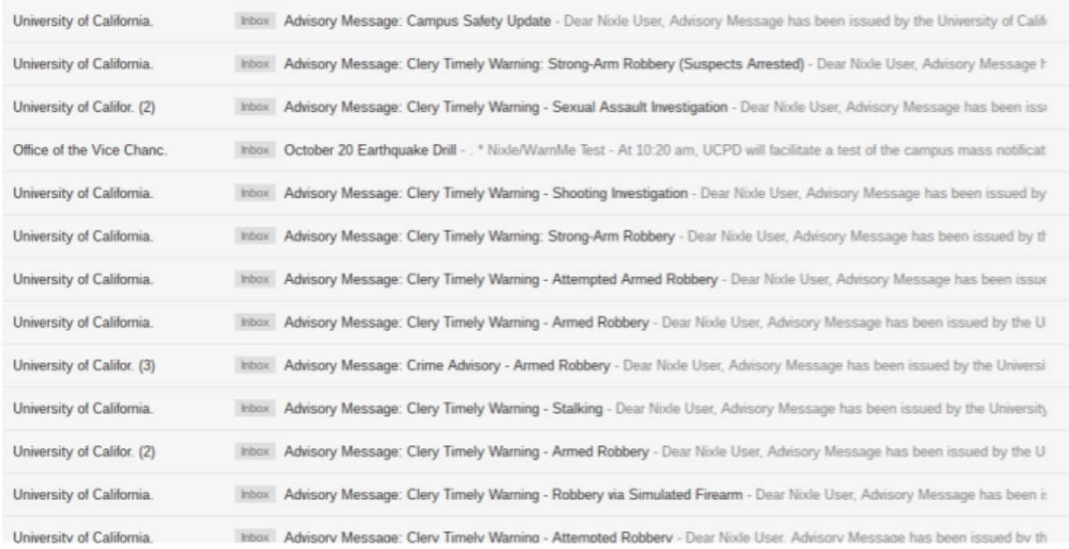
THE TRAGIC CONDITION OF EVERY BERKELEY STUDENT’S INBOX – AN ANALYSIS OF CRIMES IN BERKELEY

Slide 2
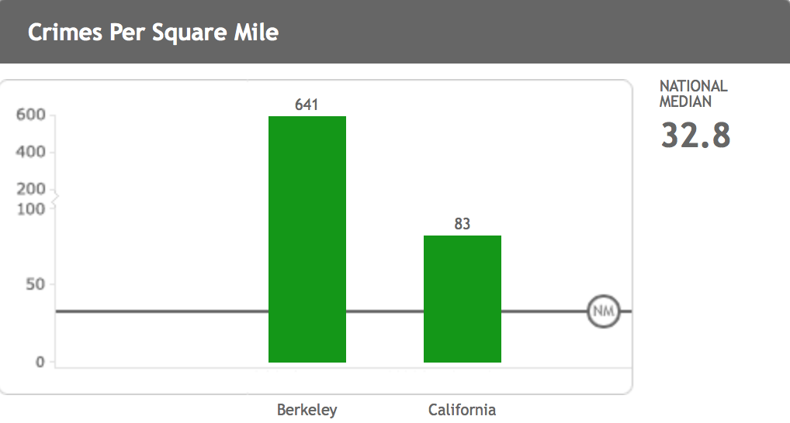
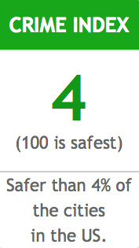
Berkeley is considered safer than 4% of the cities in the US
Source: www.city-data.com

Slide 3
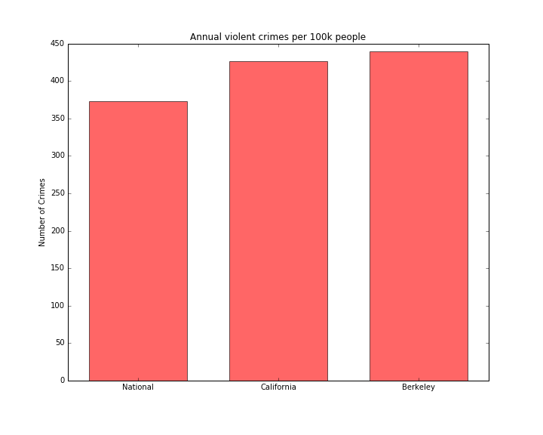
Berkeley beats the state and national average for violent crimes in a year

Slide 4
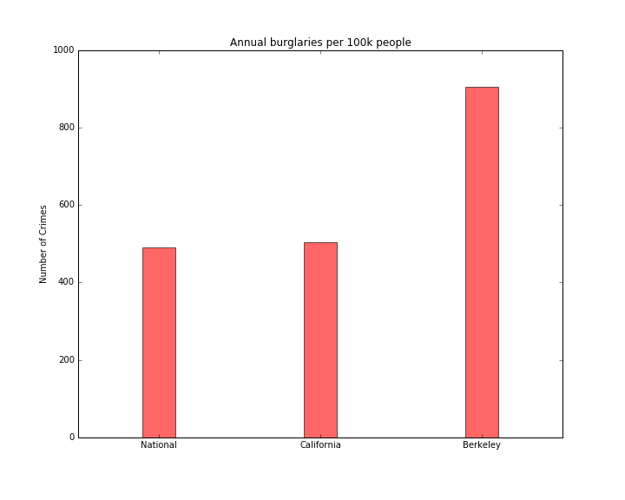
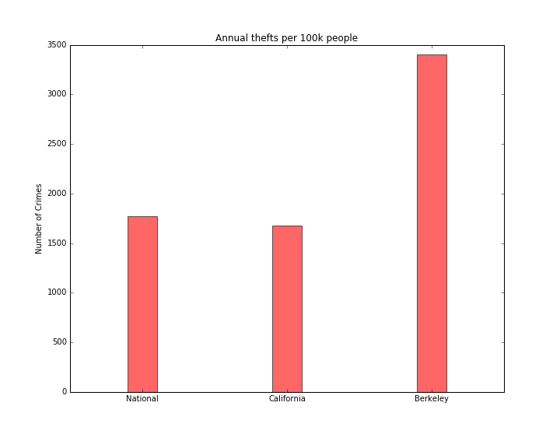
Berkeley burglaries and thefts far outscore the state and national average

Slide 5
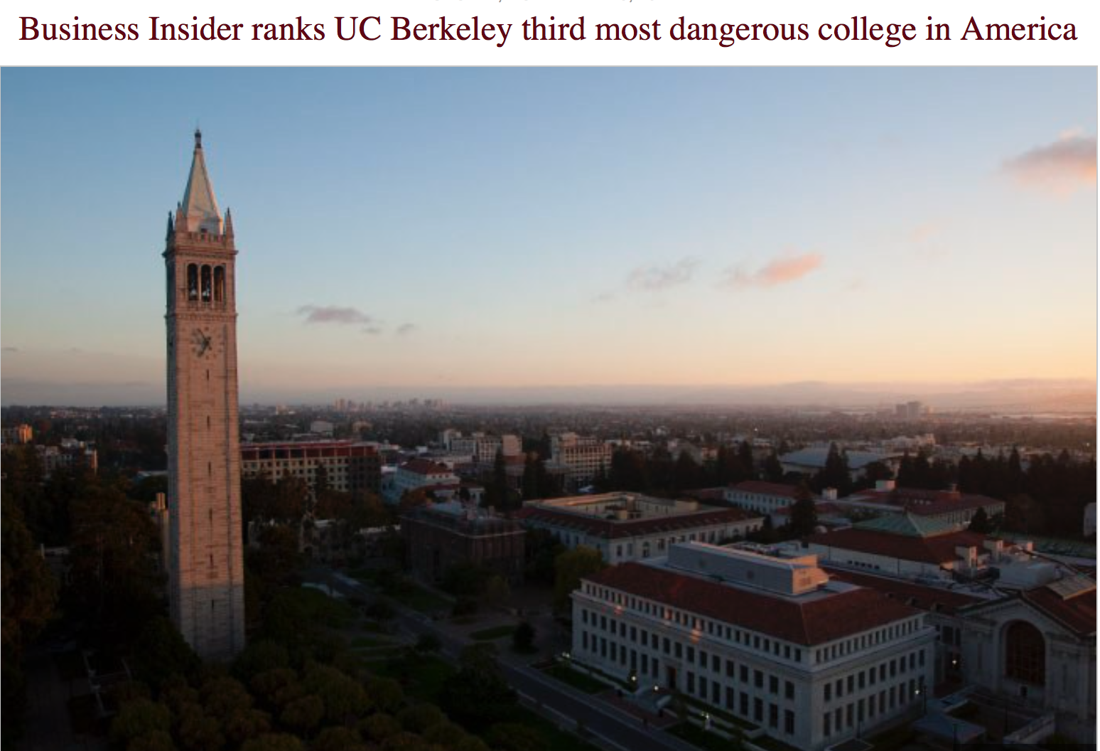

Slide 6
Crimes in Berkeley – A Spatial Look

Slide 7
Data
City of Berkeley Open Data Portal
Crime Locations
Type of Crime (Theft, Narcotics, Missing Person, Homicide, etc.)
Occurrence month
Occurrence day of the week
Occurrence time (Morning, Evening, Afternoon, Night)

Slide 8
Approach
Analysis
Crime Behavior
Crime Intensity Maps
Violent vs. Non-violent crimes
Influence of BART stations
Recommendation
Distance Optimality
Accounting for Safety of Public Schools

Slide 9
Analysis

Slide 10
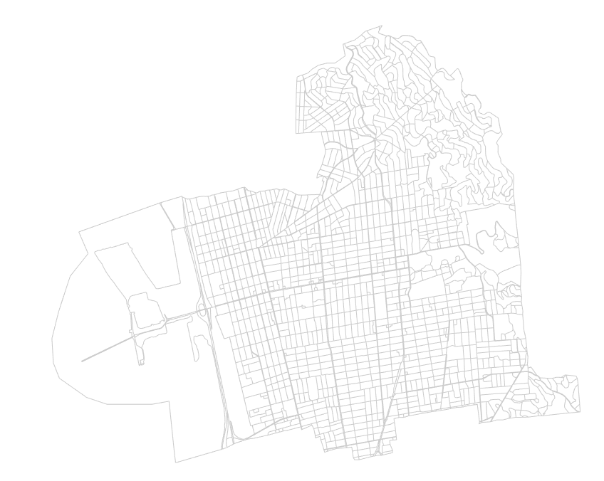
Berkeley

Slide 11
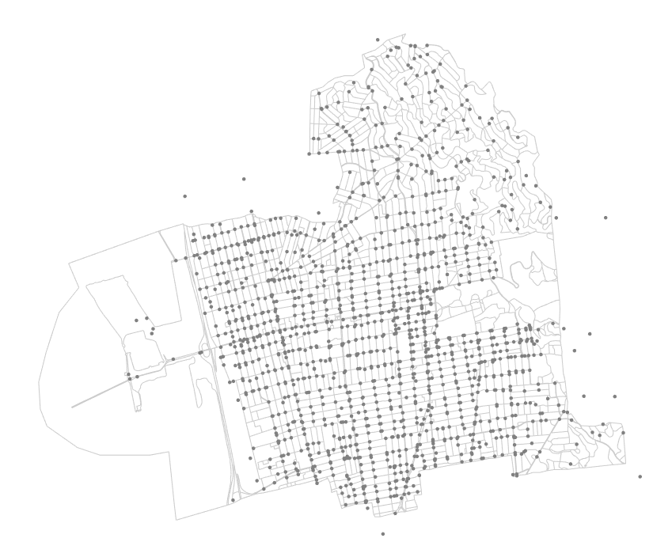
Crimes in Berkeley (2016)

Slide 12
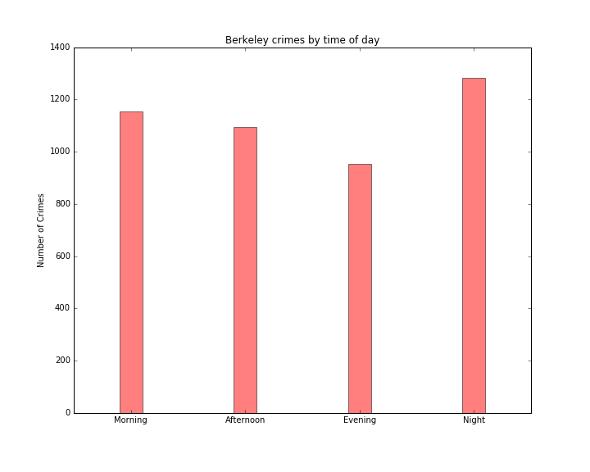

Slide 13
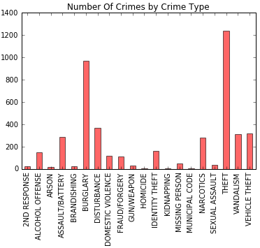

Slide 14
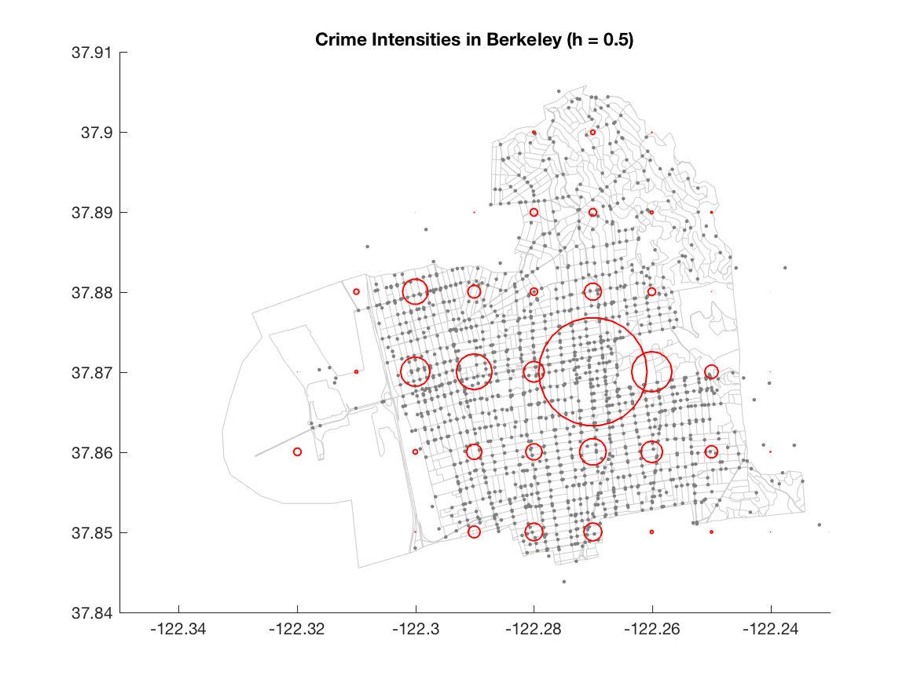
Areas close to campus and Downtown Berkeley are high-risk areas

Slide 15
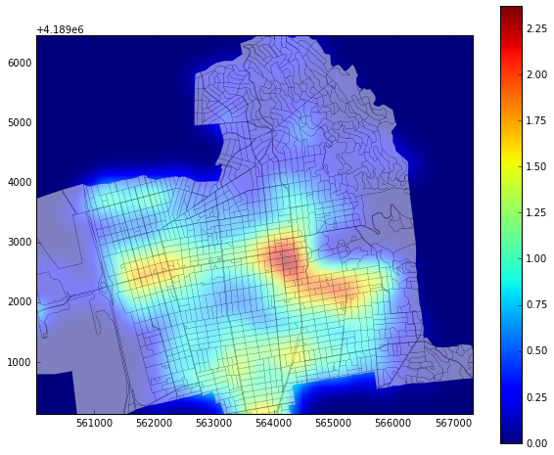
Intensity Field of crimes in Berkeley (2016)

Slide 16
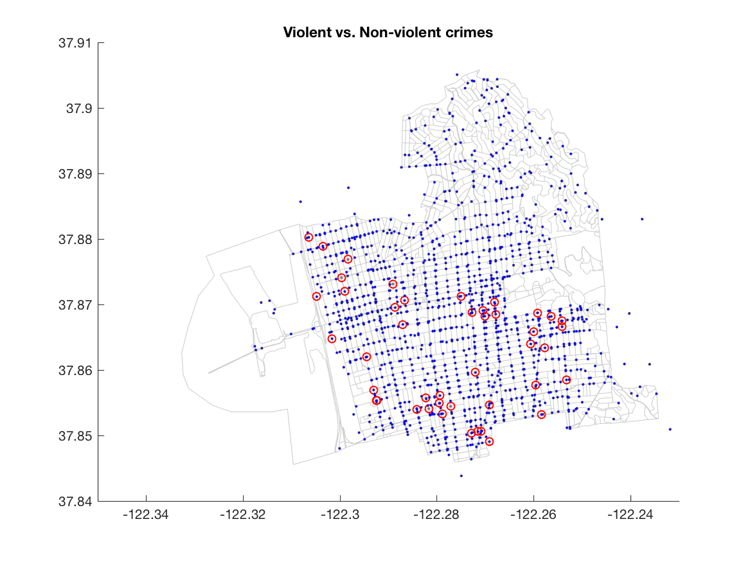
Violent crimes (red) are skewed towards the southern and western parts of Berkeley

Slide 17
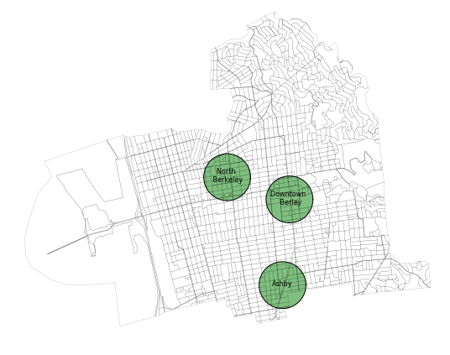
Berkeley BART stations with buffers

Slide 18
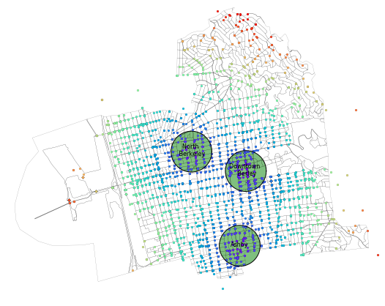
Intensity of crimes around BART stations is extremely high

Slide 19
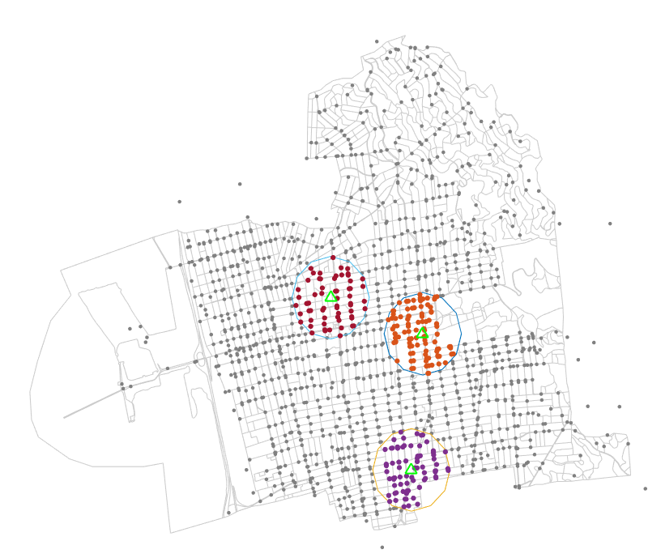
Crime intensity of Berkeley: 249 crimes/ sq. m
Crimes are clustered around BART stations
551.7 crimes/sq. m
North Berkeley
2709 crimes/sq. m
Downtown Berkeley
Ashby
884.2 crimes/sq. m

Slide 20
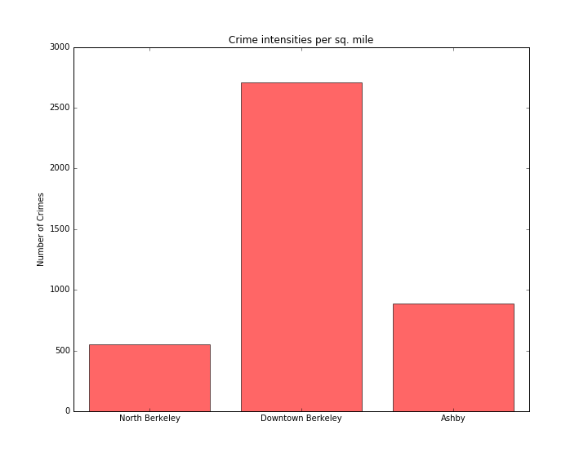
Downtown Berkeley BART station is the worst affected

Slide 21
Recommendation

Slide 22
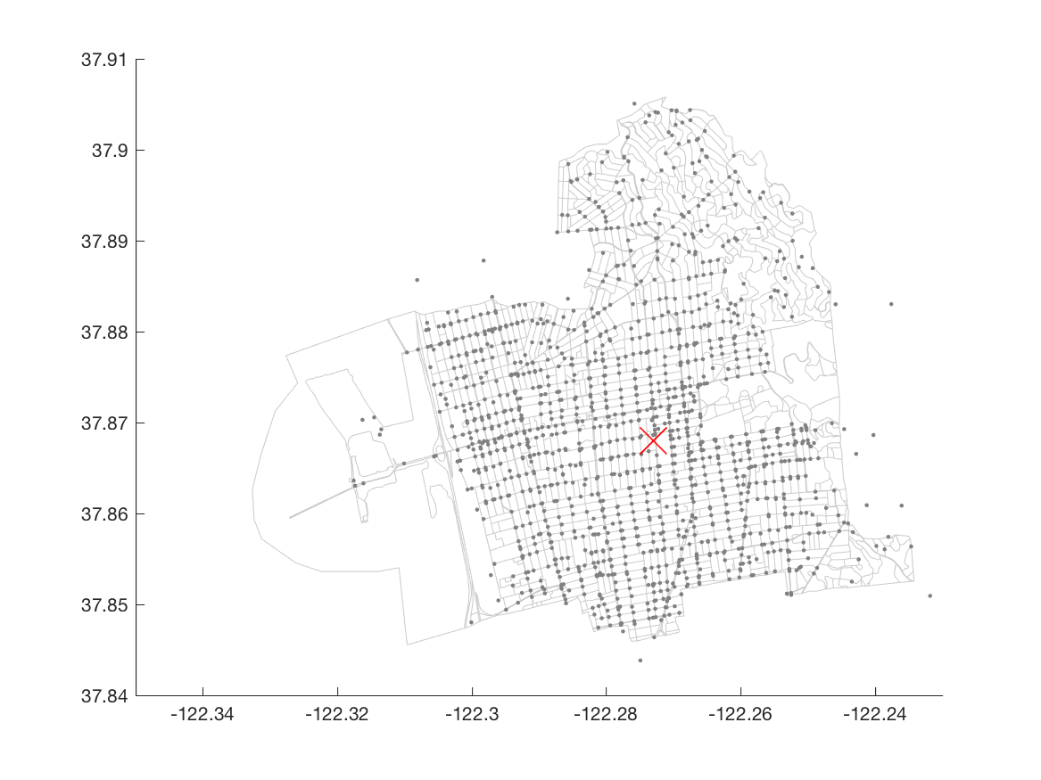
Optimal Location of Berkeley Police Station
Step 1:
Distance Optimality based on all crimes

Slide 23
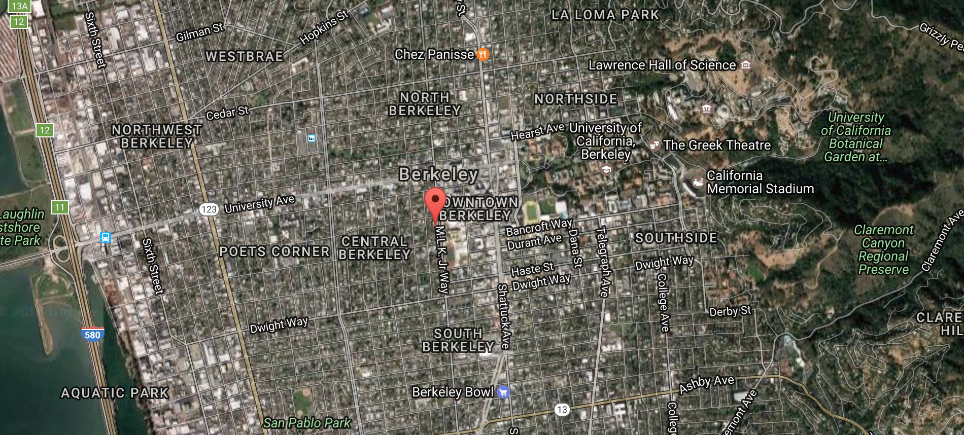

Slide 24
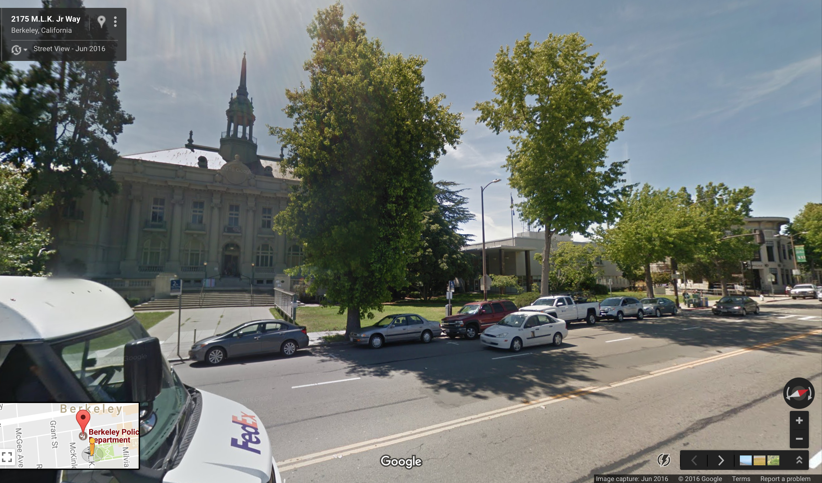

Slide 26
Berkeley Police Department

Slide 27
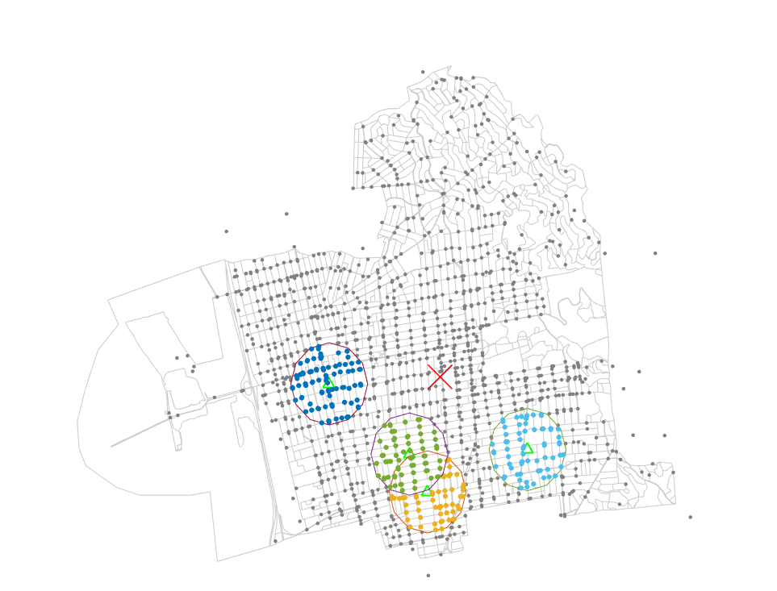
Four schools with highest crime intensities
Step 2: Taking the safety of public schools into account
Black Pine School
Willard Middle School
Malcolm X Elementary
Longfellow Middle School

Slide 28
Crime intensity of Berkeley: 249 crimes/ sq. m
Crime Intensity around the four schools is extremely high
1008 crimes/sq. m
Black Pine School
801 crimes/sq. m
902 crimes/sq. m
Willard Middle School
Malcolm X Elementary
Longfellow Middle School
606 crimes/sq. m

Slide 29
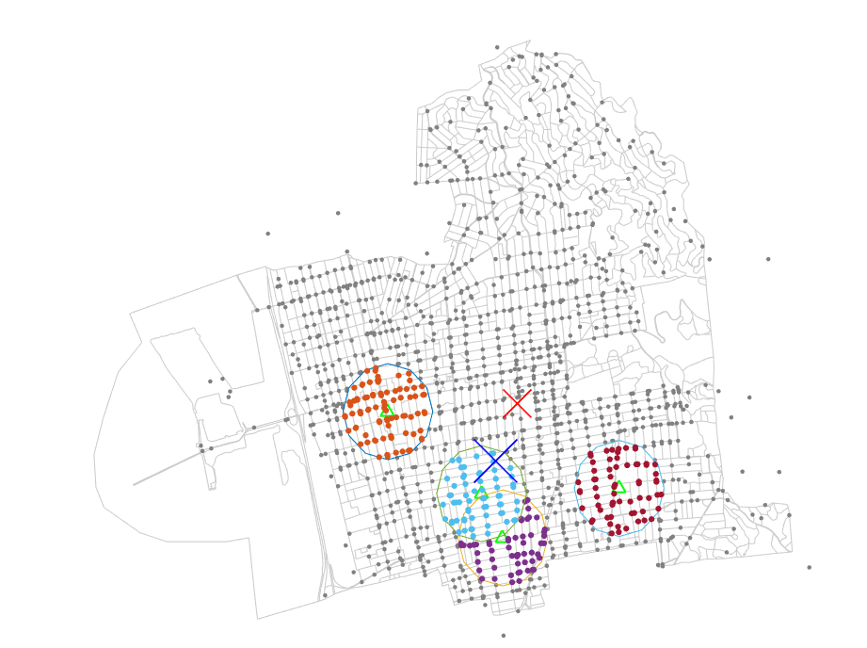
New Optimal Police Station prioritizing school crimes
Prioritizing the school crimes in the distance optimality calculation provides a more optimal location for the police station
Previous Optimal Police Station
Black Pine School
Willard Middle School
Malcolm X Elementary
Longfellow Middle School

Slide 30
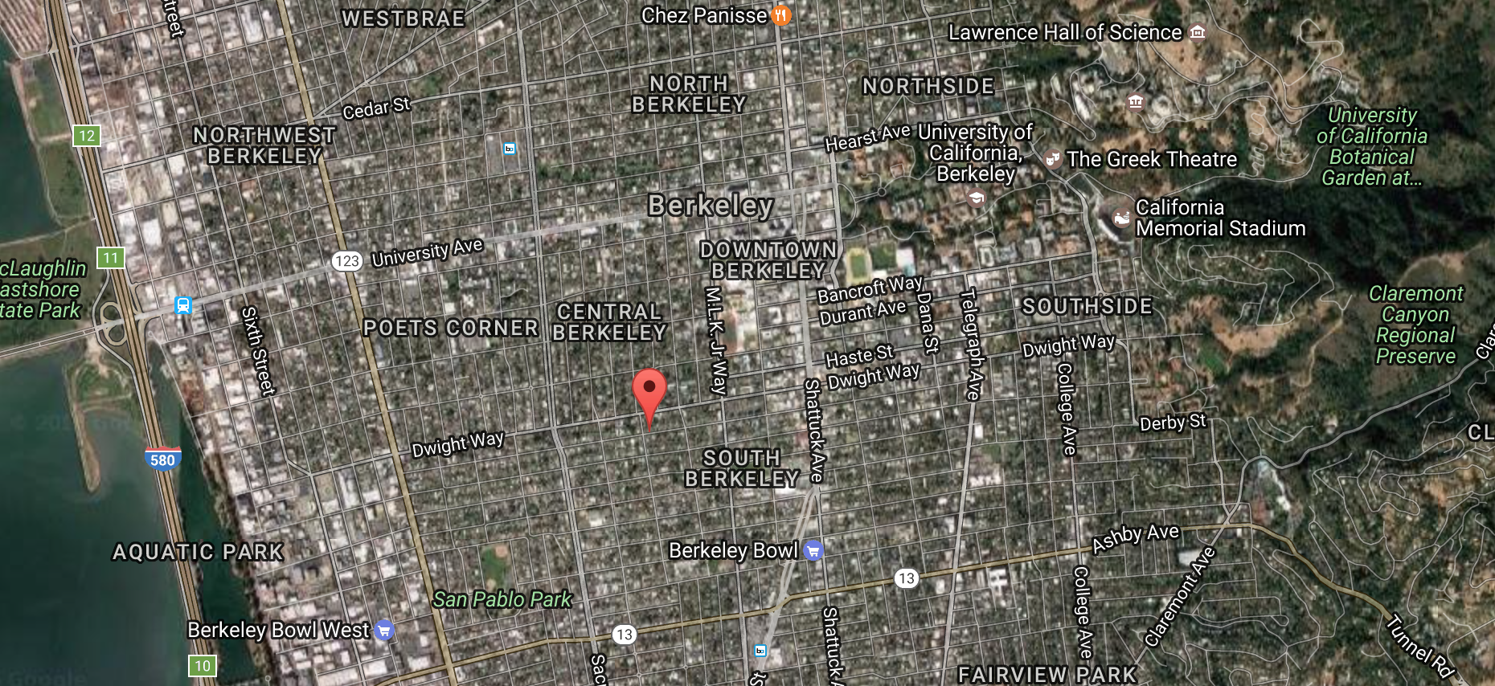

Slide 31
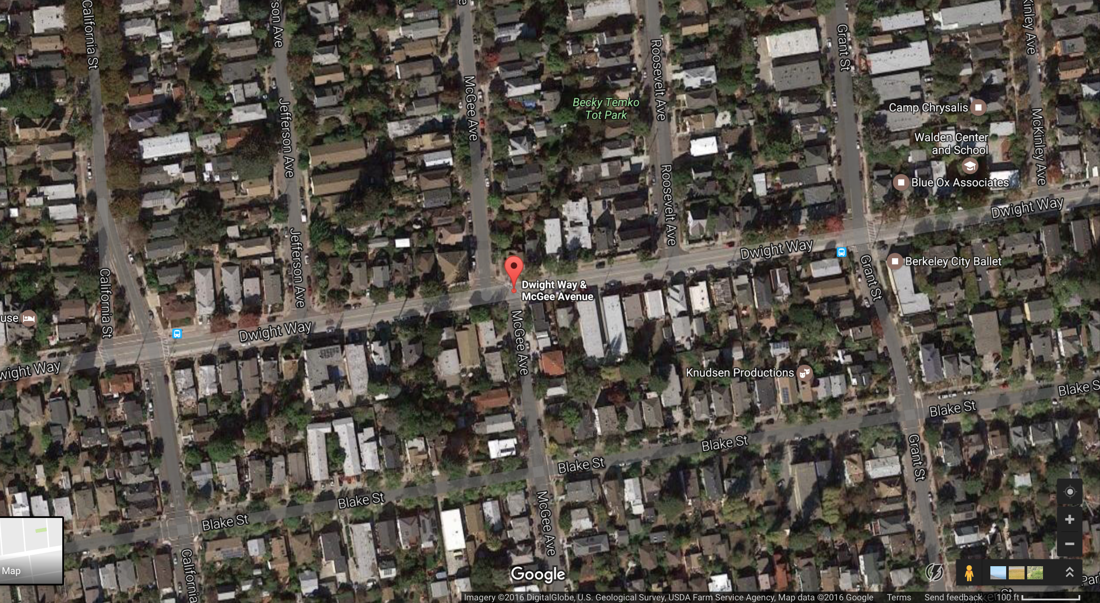

Slide 32
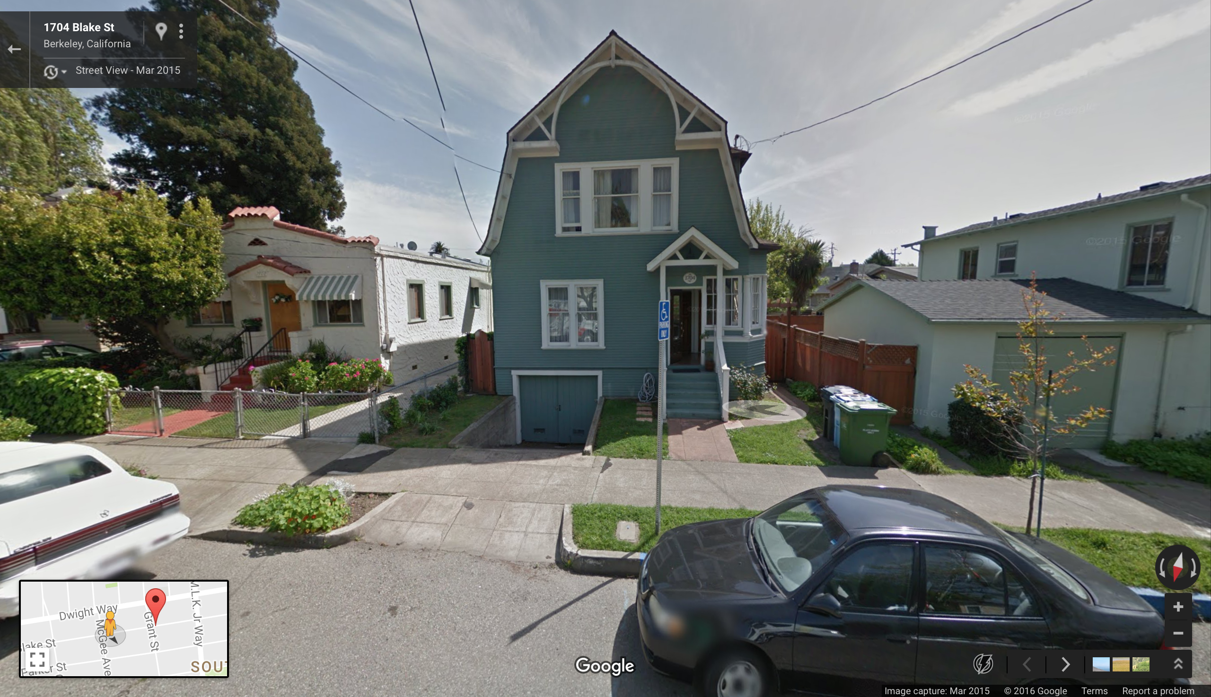

Slide 33
Thank You. Stay Safe!
Shirish Dhar

